Slide 1

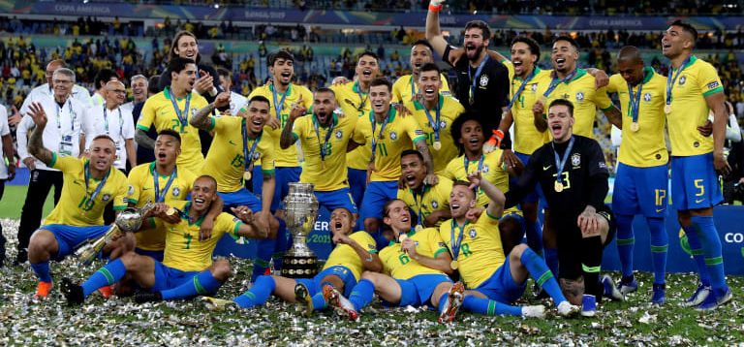
FIFA 2K19

Slide 2
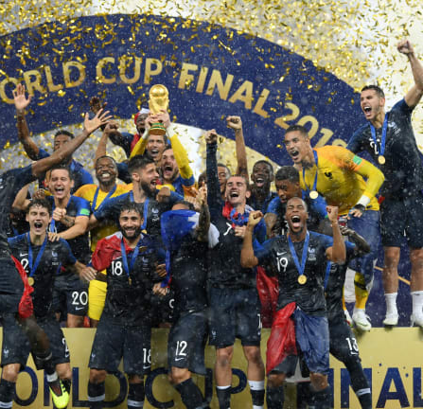
Introduction
Football is one of the most famous sport in the world.
More than half of the world saw the famous 2018 world cup.
Audit tells the total viewership of 3.572 billion for the last world cup.

Slide 3
End User and Business Objective
End User- Club Owners, Players, Gamers, Football Fans and Viewers
Business Objective-
To Show Club Owners the best Players and their skills
To Show Player their skills and shortcomings
To Show Gamers the best clubs and players to choose and play in the game

Slide 4
Fifa 19 Data
The Data is taken from Kaggle.
It has only one table.
Each table has 18207 rows and 84 columns.
The reason for taking this Dataset is because it has a usability rating of 10 in Kaggle and we all are big fans of football and fifa as we watch it every year and we are really interested in football.

Slide 5
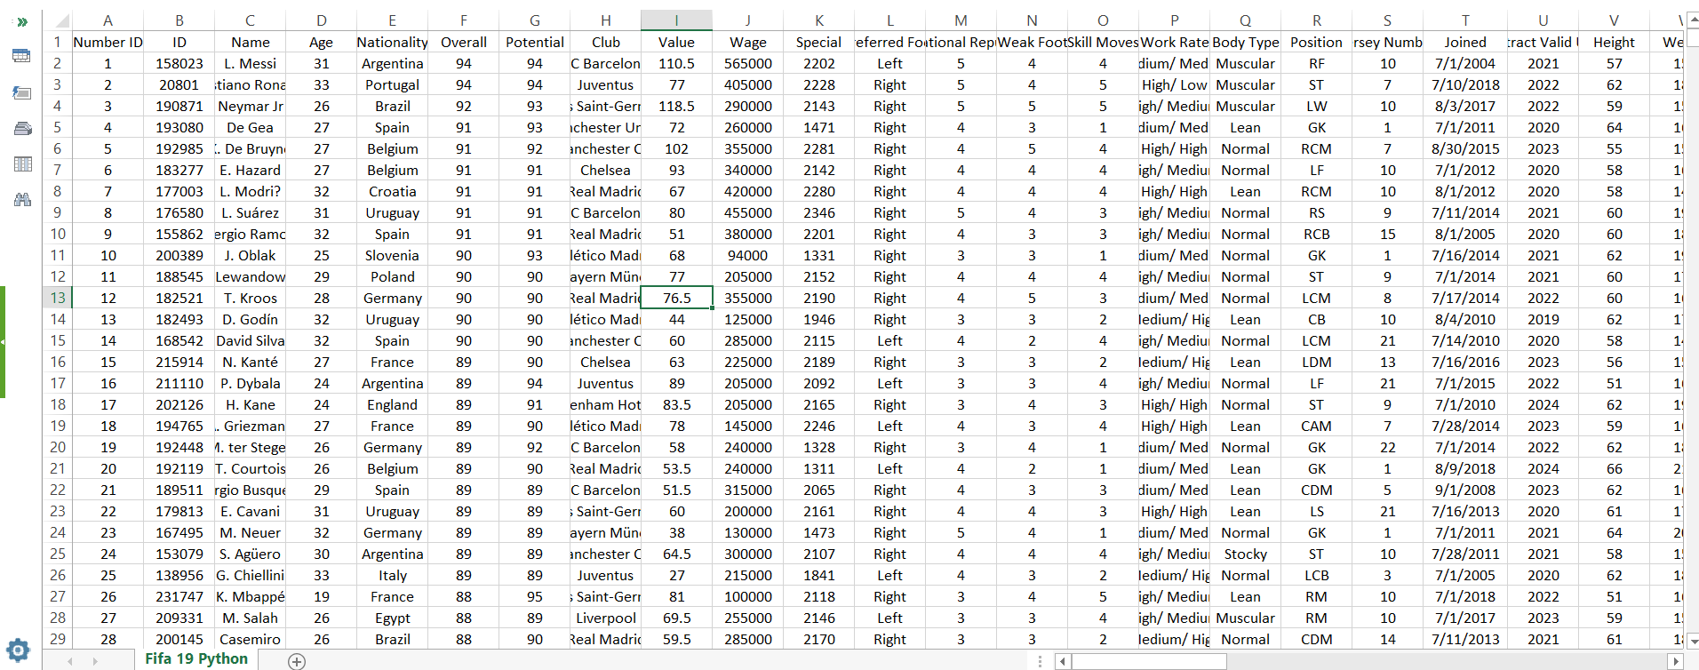

Slide 6
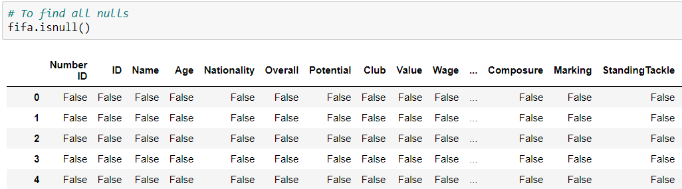
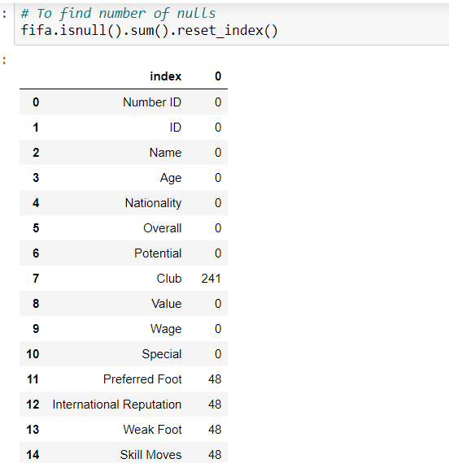
Data Cleaning and Metadata Exploration
1)To find Null
2)To Find total Number of
Nulls using Sum

Slide 7
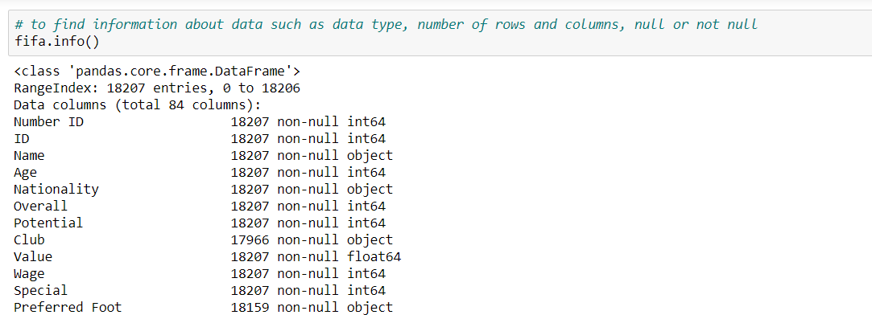
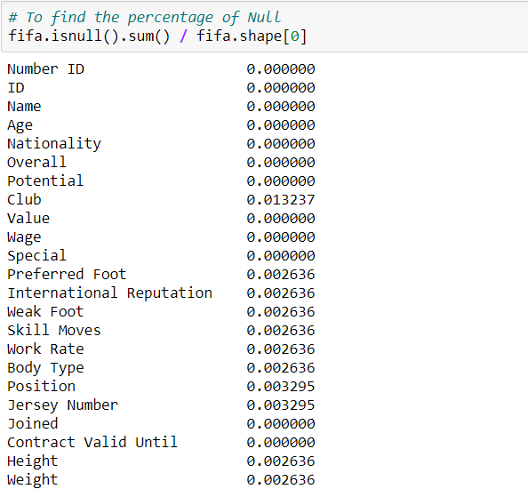
3)To find information about data type, null or not null, No of rows and columns
4)Finding the percentage of null in each columns

Slide 8
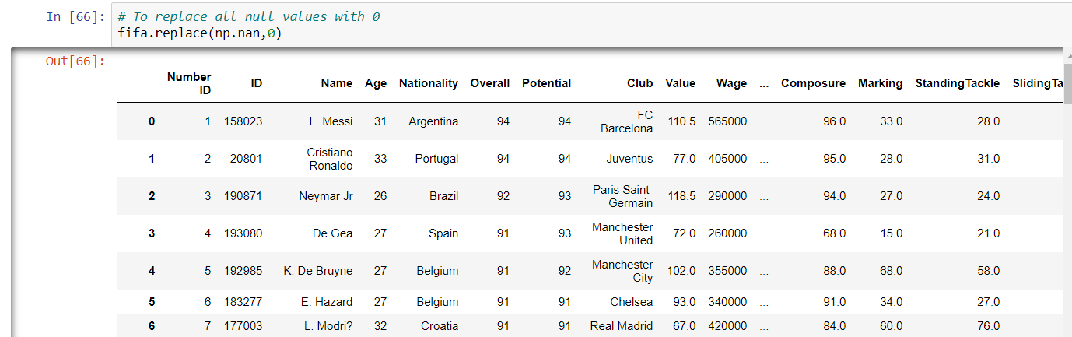
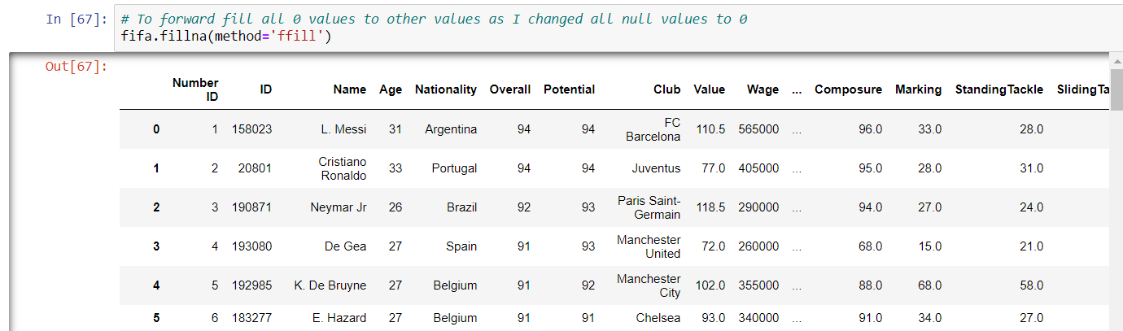
5)Replace all null values with zero
6)Used Forward Fill to fill all blank and null values

Slide 9
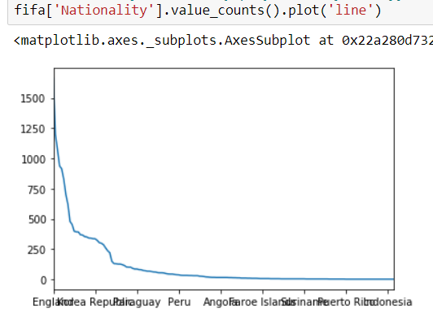
Data Analysis
1)Top 3 players with highest potential and highest overall skills are
Lionel Messi, Cristiano Ronaldo and Neymar
2)Top 3 countries with the highest number of player are Germany, England and Spain that is 1662, 1198, 1072

Slide 10
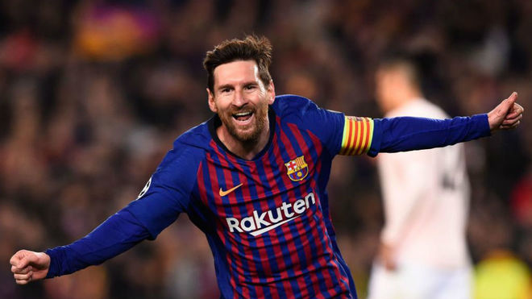
4). Top 5 player with Normal body type with their crossing, headingaccuracy, shortpassing, dribbling and ballcontrol skills are K.De Bruyne, E. Hazard, L.Suarez, Sergio Ramos, J. Oblak
5) Players with overall skills 94, 92 and 91 are the highest paid players.
Highest Wage earning player is Lionel Messi with €565000 wages.

Slide 11
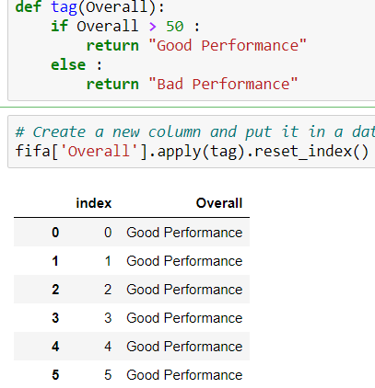
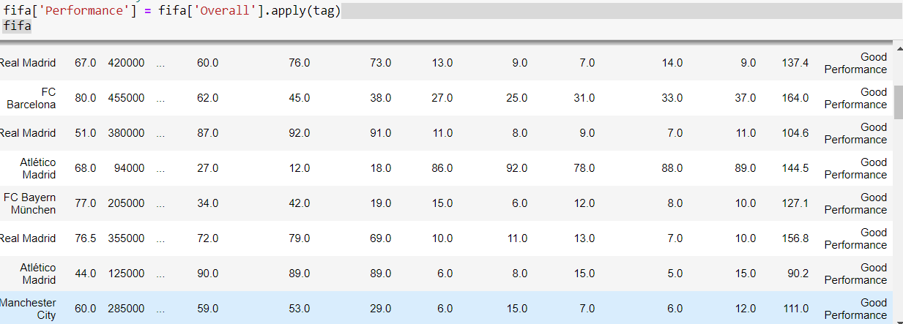
6) Created a custom function to see Performance of each player whether it is a good performance or bad performance
According to the custom function if overall skills of a player
Is above 50 then they have good performance else they
Have a bad performance.

Slide 12
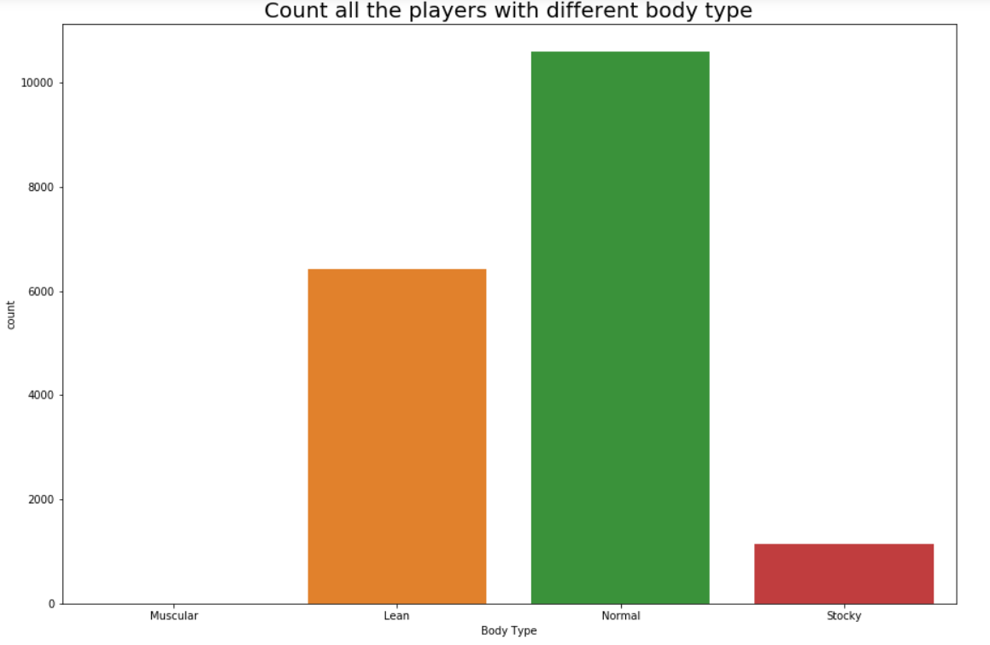
6) Bar Graph Showing Number of Players with different body type

Slide 13
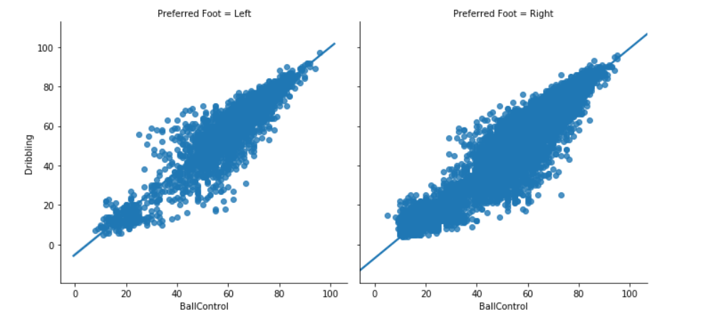
7) Dribbling and ballcontrol ability of players with different preferred foot such as left and right

Slide 14
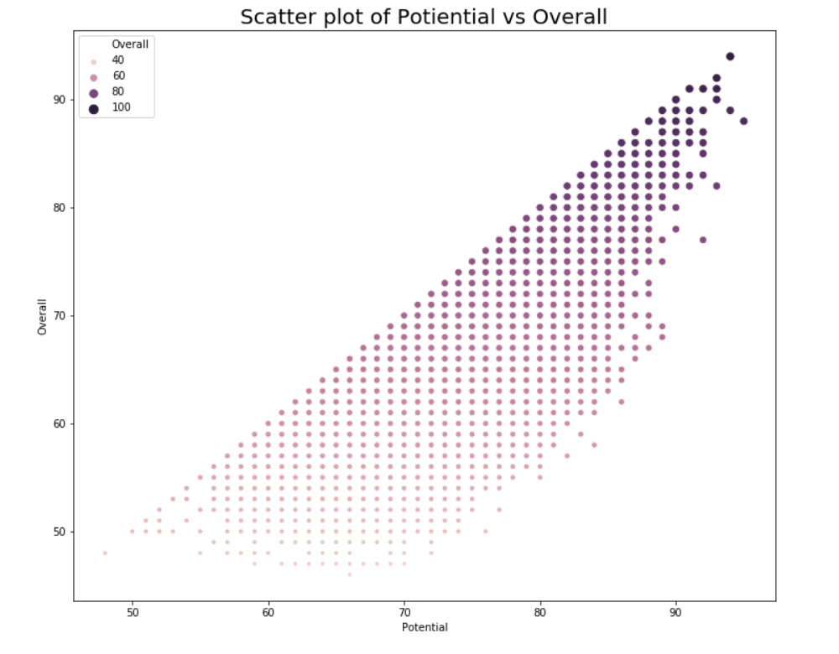
9) Scatter plot showing Potential vs Overall skills of players

Slide 15
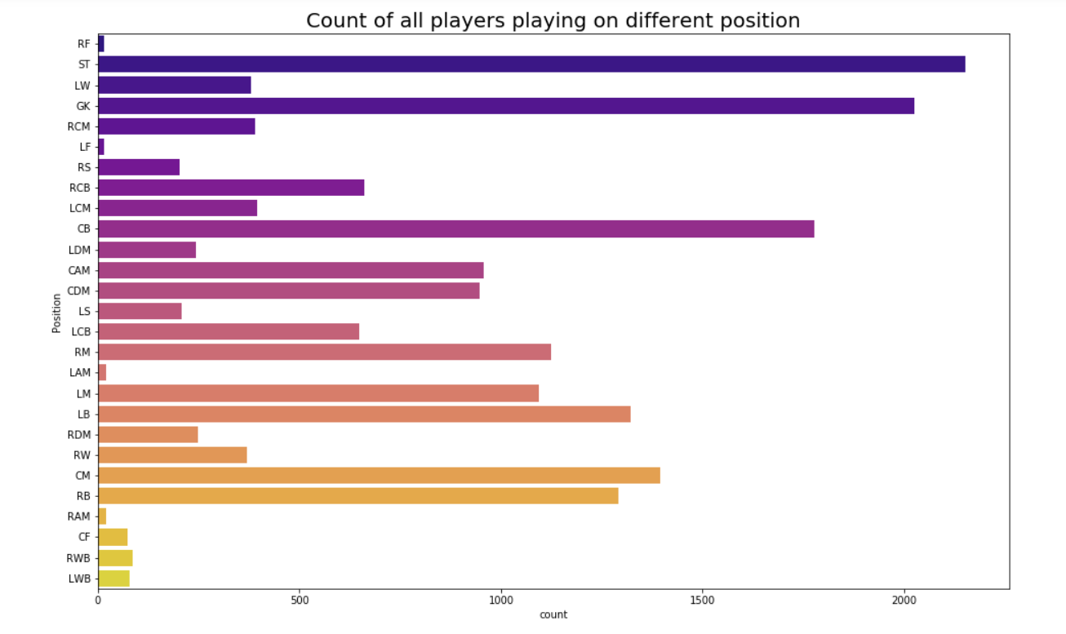
8) Number of Players playing in different positions in football

Slide 16
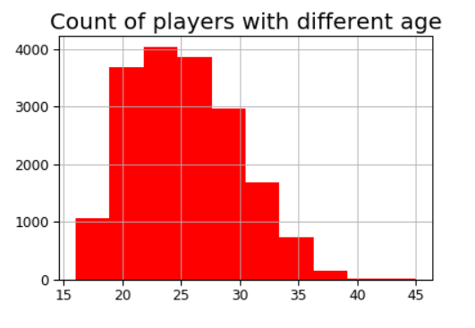
10) Histogram showing number of players with different age

Slide 17
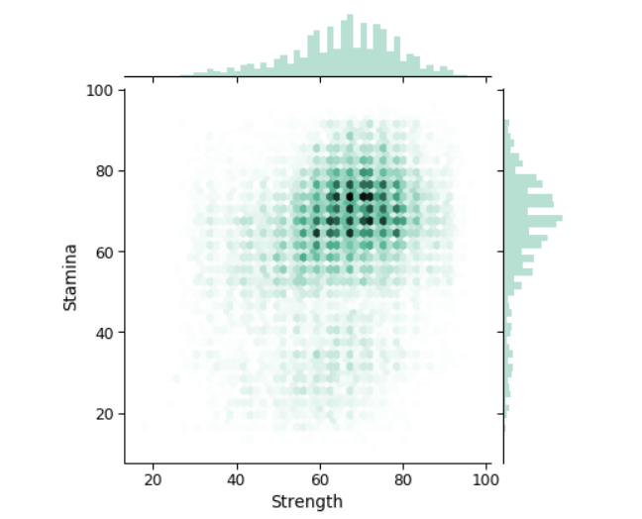
11) Joint plot showing Strength and Stamina in different players

Slide 18
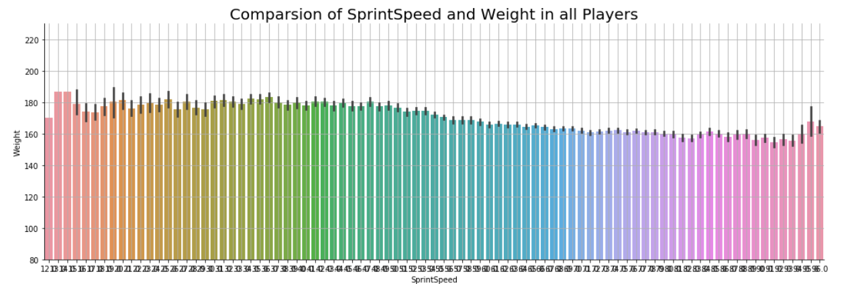
12) Cat plot showing Comparison of Sprint Speed and Weight in all Players

Slide 19
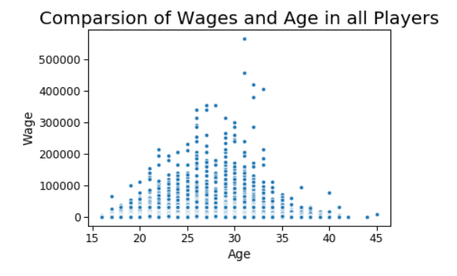
13) Scatter Plot showing Comparison of Wage and Age in all Players

Slide 20
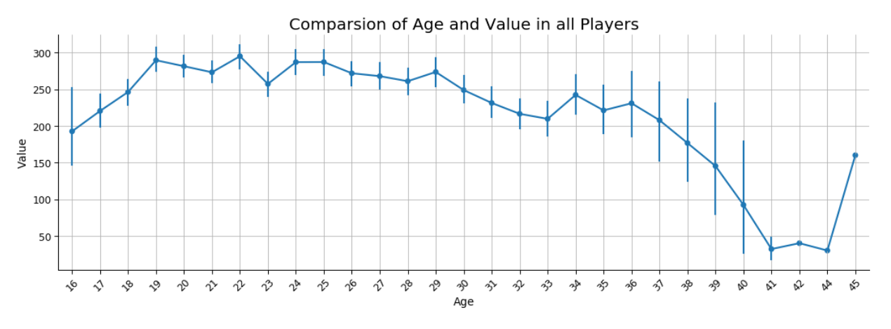
14) Cat Plot showing Comparsion of Age and Value in all Players

Slide 21
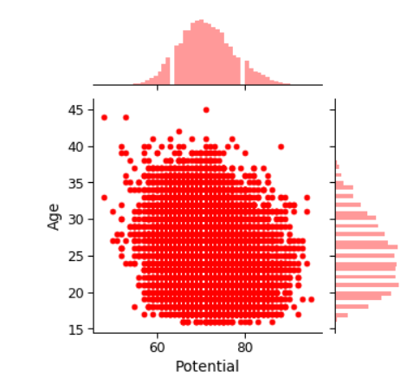
15) Joint Plot showing comparison of age and potential in all players

Slide 22
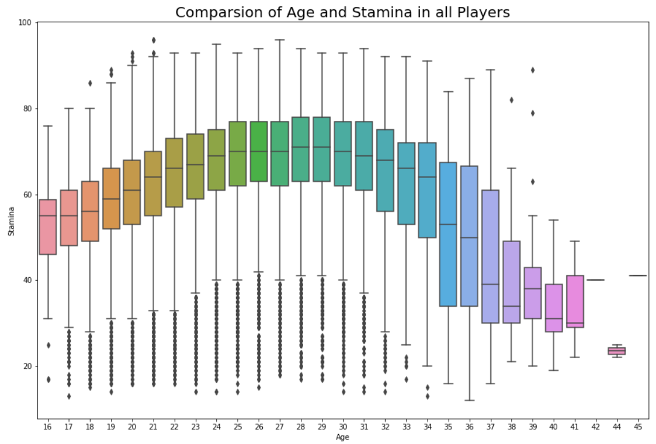
16) Box Plot showing comparison of age and stamina in all players

Slide 23
Technical Learning Skill
fifa.corr()
fifa.describe()
Ffill
Fifa.info()
fifa.replace(np.nan,0)

Slide 24
Unanswered Questions
Regression
Decision Tree
Predictive Analytics
Prescriptive Analytics

Slide 25
GitHub
David - https://github.com/Davidjose641/Python
Vaishak- https://github.com/vaishakrajikumar/Ragnar

Slide 26


